Slide 1
Project Management App
Presented By:
N-SPARKS

Slide 2
Project Background
This web application can be used to manage the projects of an NGO end-to-end.
This application can be used for the following:
Project planning
Project scheduling
Employee Management
Fund Management
Inventory Management
Change Management
Statistical analysis through graphs

Slide 3
Technologies Used
Web Development Framework : ASP.Net MVC
Backend : Microsoft SQL Server – LocalDB
Frontend : HTML5, Javascripts, JQuery, Bootstrap CSS
Why this framework :
Faster development
Most common design pattern
Tightly-coupled & event driven
Components/controls on a design surface/canvas
UI & business logic is mixed together
Inline scripting model
Simplified top-to-bottom execution
Extremely flexible and extensive

Slide 4
Functionality Implemented
CRUD operations for Projects
Parent/Child project association
Assigning funds to Projects
Assigning stakeholders to Projects
Export report in form of Pdf/Excel/Doc/Image
CRUD operations for Funds
Managing funds between parent and child projects
CRUD operations for Stakeholders
Updating roles of the stakeholders
The default Admin User – admin@pma.com, will be present from start and cannot be deteled.
CRUD operations for Roles
New roles can be managed
Default Roles present are : Admin, Manager, Individual
Default Roles cannot be edited
Viewing graphs for statistical analysis
(cont.)

Slide 5
Functionality Implemented (Cont.)
Role based access control
Admin has all the privileges:
Project Management
Fund Management
Inventory Management
Stakeholder Management
Statistical analysis of graphs
Generate reports
Manager has the following privileges:
Project Management
Stakeholder Management
Statistical analysis of graphs
Generate reports
Individual has the following privileges:
View project details assigned to him
Log expenses for the assigned project
Statistical analysis of graphs
Generate reports
Searching and Sorting in all views

Slide 6
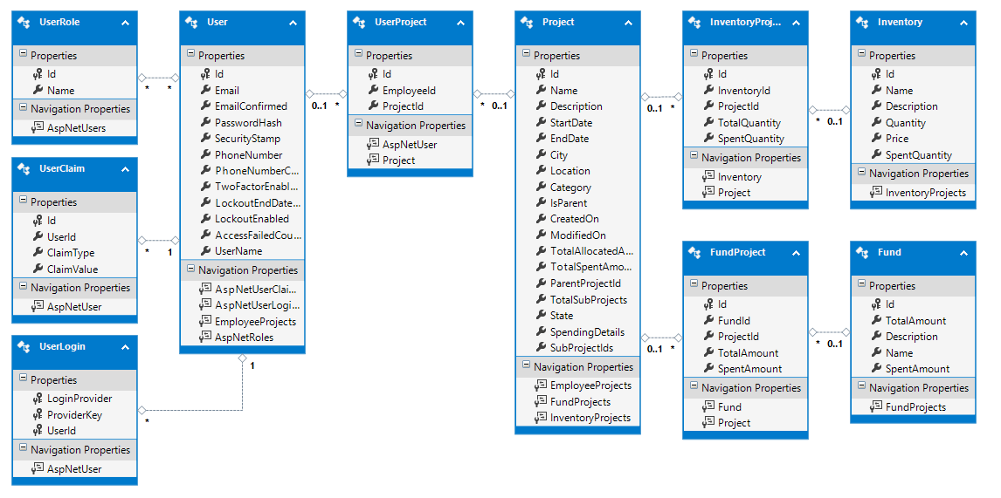
Schema Design

Slide 7
Webservice Design
The webservice uses Model View Controller Pattern
This has the following benefits:
(SoC) Separation of Concerns.
REST friendly URL.
Test Driven Development (TDD)
Better Integration with JavaScript
Stateless design
FULL control over the rendered HTML.
Extensibility (supports third-party view engines)
Less code duplication, easier to maintain over time.
UI
(VIEW)
MODEL
Persistence
(typically a database)
Request
Response

Slide 8


MVC Design
2. Pass incoming parameters
3. Resultant data
Model
1. HTTP Request
6. HTTP Response
4. Pass Model
Controller
5. GUI content (HTML)
View

Slide 9
Build and Test
Build Pre-requisite:
Visual Studio 2013 Update 3 with following mandatory features:
Microsoft SQL Server Data Tools
Microsoft Web Developer Tools
Build
Checkout code and open the code in Visual Studio 2013 Update 4
Go to BUILD menu, choose “Build Solution”
Test
Ensure full privileges full project folder
Go to DEBUG menu, choose “Start Without Debugging”
URL opens in default browser with default login page
Login with default management user:
User – admin@pma.com
Password – Admin@123a
NOTE:
Cross browser compatibility
Mobile compatibility

Slide 10
Deployment Pre-requisites
Windows Operating System
Microsoft .Net framework 4.5.1
IIS feature needs to be installed
Click the Start button , click Control Panel, click Programs, and then click Turn Windows features on or off. ...
In the list of Windows features, select Internet Information Services, and then click OK.
SQL Server Express

Slide 11
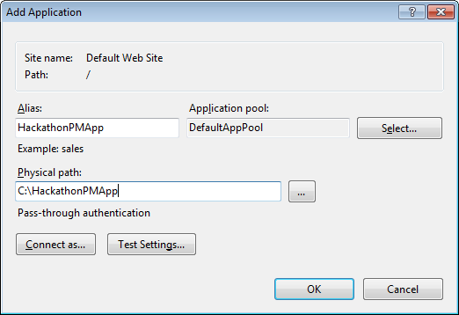
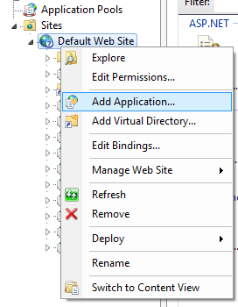
Deployment Model
Open IIS( inetmgr.exe)
Create the new Application by right clicking on Default WebSite
Click on connect as.. Button. Click on Specific user to allow user to have permission to access the application.
Enter Machine user name and password and click ok.

Slide 12
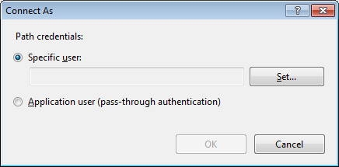
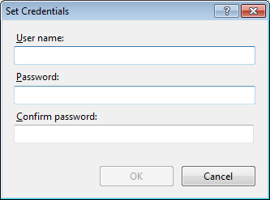
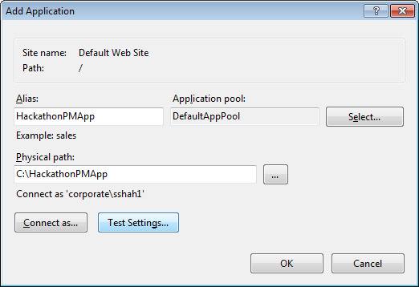
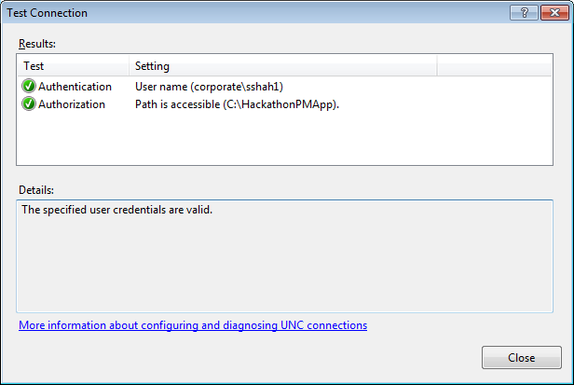
Deployment Model
Click on Test Settings.

Slide 13
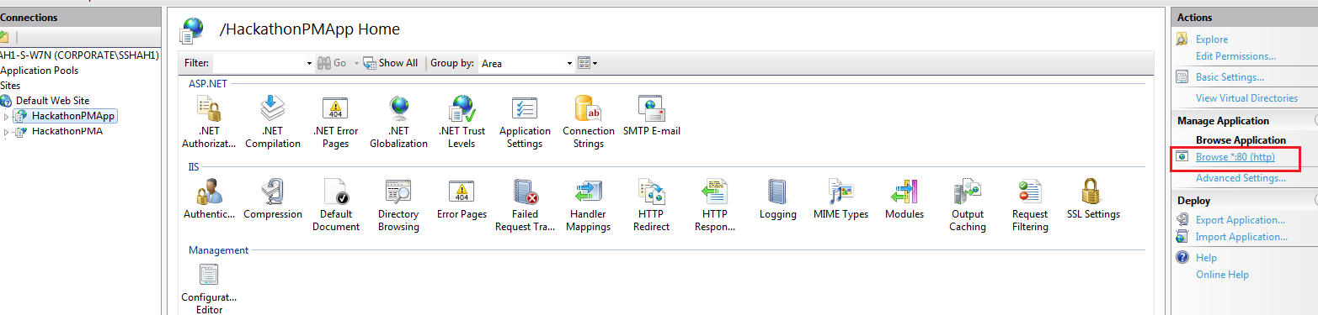
Deployment Model
Now select the profile HackathonPMApp and click on browse.

Slide 14
Enhancements
The following features have been designed and partly worked upon. Our webapp can be easily extended for these functionalities:
Dynamic evaluation criteria for projects
Mailing out the reports

Slide 15
Git Hub Links
Code is checked in under
https://github.com/nalininallamalli/NSPACKS_PROJECT_MGMT

Slide 16
Thank You
Please free to contact the team N-SPARKS on the below contact information :
Nalini Kumari Nallamalli
Email : Nalini.Nallamali@veritas.com
Contact : +91-986027440
Amruta Kulkarni
Email : Amruta.Kulkarni1@veritas.com
Contact : +91-9730644411
Reshma Ladi
Email : Reshma.Ladi@veritas.com
Contact : +91-9766624158
Seema Shah
Email : Seema.Shah@allscripts.com
Contact : +91-9974031101
Shivani Sharma
Email : Shivani.Sharma@allscripts.com
Contact : +91-8866170248
Pooja Desai
Email : Pooja.Desai@veritas.com
Contact : +91-9423206150
Kanchan Karve
Email : Kanchan.Karve@veritas.com
Contact : +91-9923403347

